Slide 1


The National Research Platform
Fall Training Series
Mohammad Firas Sada
University of California, San Diego
San Diego Supercomputer Center

Slide 2
Important Notice
This training is intended as a supplement to the official NRP Documentation.
While the content presented here is accurate as of today, the official documentation is the primary and most up-to-date source of truth.
Please refer to https://nrp.ai/documentation/ for the latest information and updates.

Slide 3
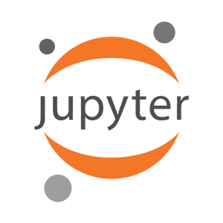


Using Nautilus and NRP
JupyterHub
Coder
Kubernetes
To access any of these services, you need to be part of a namespace/group on: https://nrp.ai/namespaces/

Slide 4
Using NRP’s JupyterHub
National Research Platform Fall Training Series

Slide 5
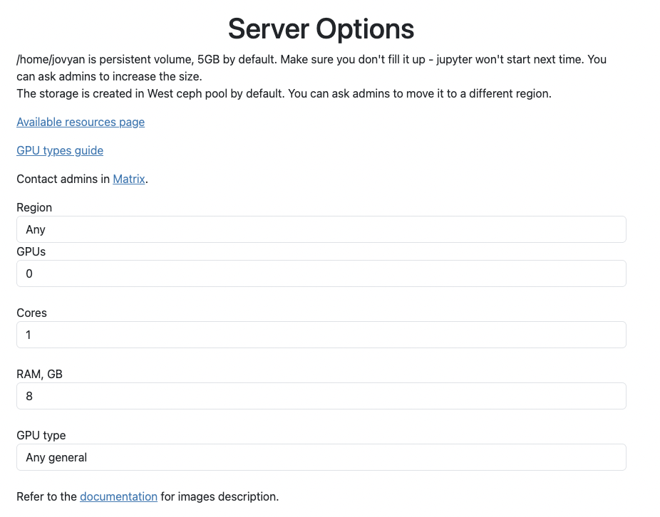
JupyterHub
https://jupyterhub-west.nrp-nautilus.io/
https://jupyterhub-east.nrp-nautilus.io/
We host two JupyterHub instances
Login via CILogon with your university credentials
You can choose resources like CPUs, GPUs, GPU type, RAM, etc
NRP provides several pre-built images
Read our docs to learn more: https://nrp.ai/documentation/userdocs/jupyter/jupyterhub-service/

Slide 6
JupyterHub Features
JupyterHub implements “culling”, not interacting with session will lead to auto-termination.
Jupyter-AI
Uses NRP’s LLMs (Free)
Provides Cell Debugging
Provides Entire Notebook Generation
Chatbot
Bring Your Own Provider

Slide 7
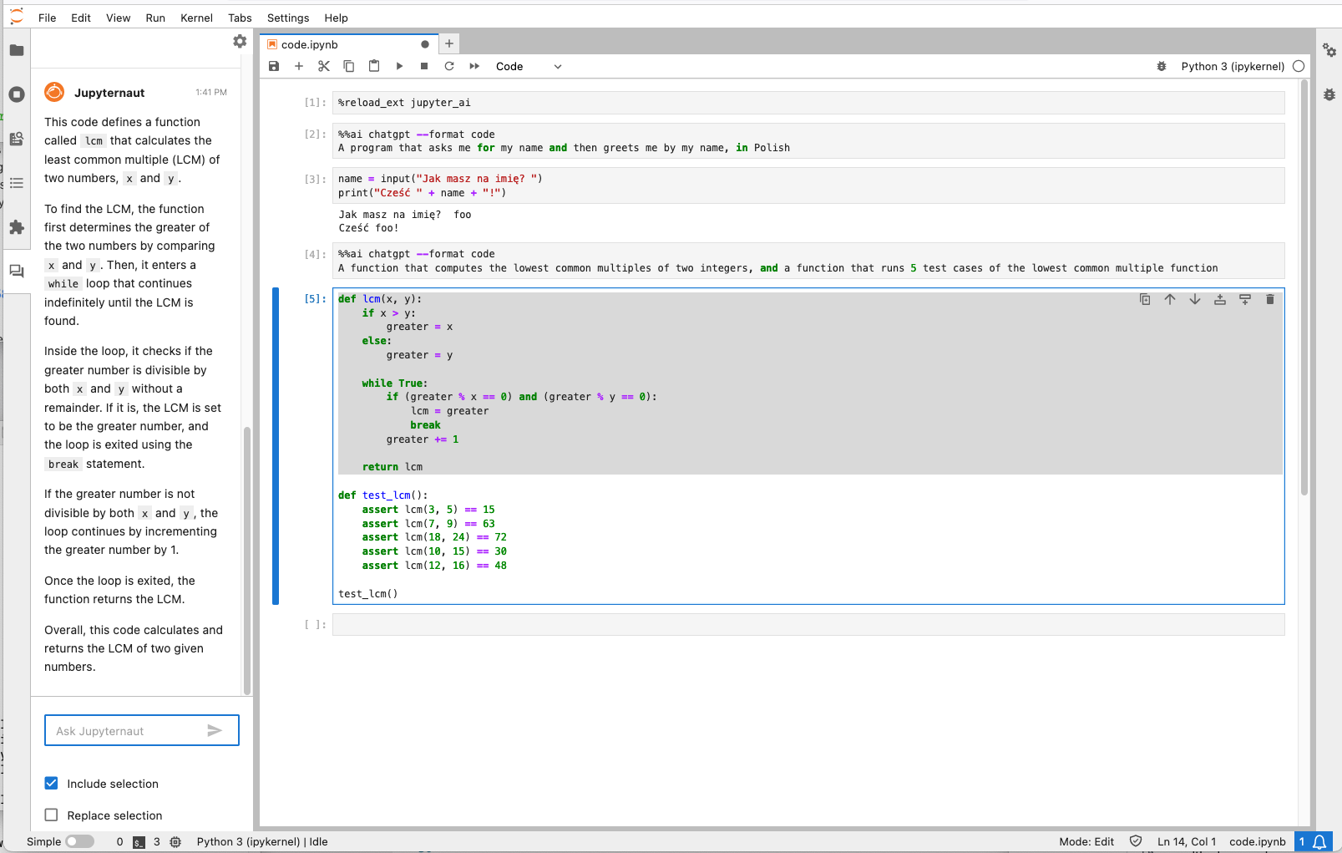
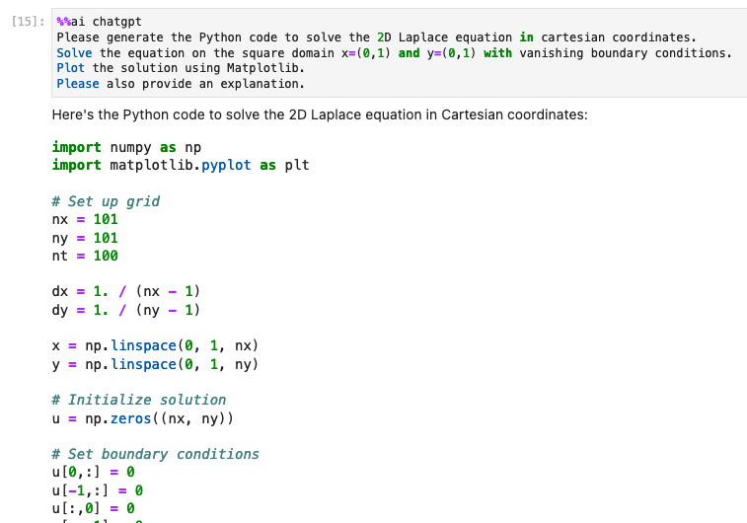
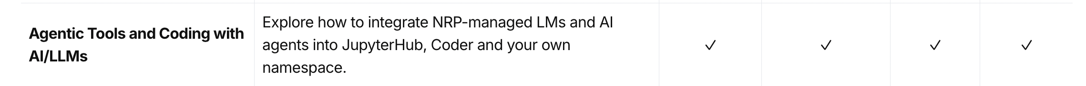
JupyterHub Features
Jupyter-AI
Jupyter Magics
Jupyternaut Side Panel

Slide 8

Q&A
National Research Platform Fall Training Series

